Slide 1
Using Drones Safely & Legally
Presented by Dan Weecks

Slide 2
About the Presenter
Founder of Weecks Productions, LLC, a multi-media production company based in Phoenix.
Previously a TV Host, Producer, and Film Festival Director.
Zeitgeist Medien Fest (ZMF) Intl. Film Festival
The Talk Around Town Show
Direct digital distribution, streaming platforms, viewership in 100+ countries
Puppy Pilots
Prime-time in Japan, partnered with “The Dodo”, direct digital dist.
FAA Certified Commercial Pilot and Flight Instructor
American Ninja Warrior
The “Puppy Pilot Ninja”
Presented by Dan Weecks | www.WeecksProductions.com

Slide 3
What are drones?
The term “drone” is usually used to describe an un-manned aircraft. The proper term is “Unmanned Aerial Vehicles” (UAV).
Small Unmanned Aircraft Systems (sUAS) are a UAV or unmanned aircraft which weighs less than 55lbs for use in civilian operations in the United States, as defined by NASA¹.
Drones were originally developed for military and aerospace industrial applications, however, became more mainstream because of the efficiency and enhanced safety.
Presented by Dan Weecks | www.WeecksProductions.com

Slide 4
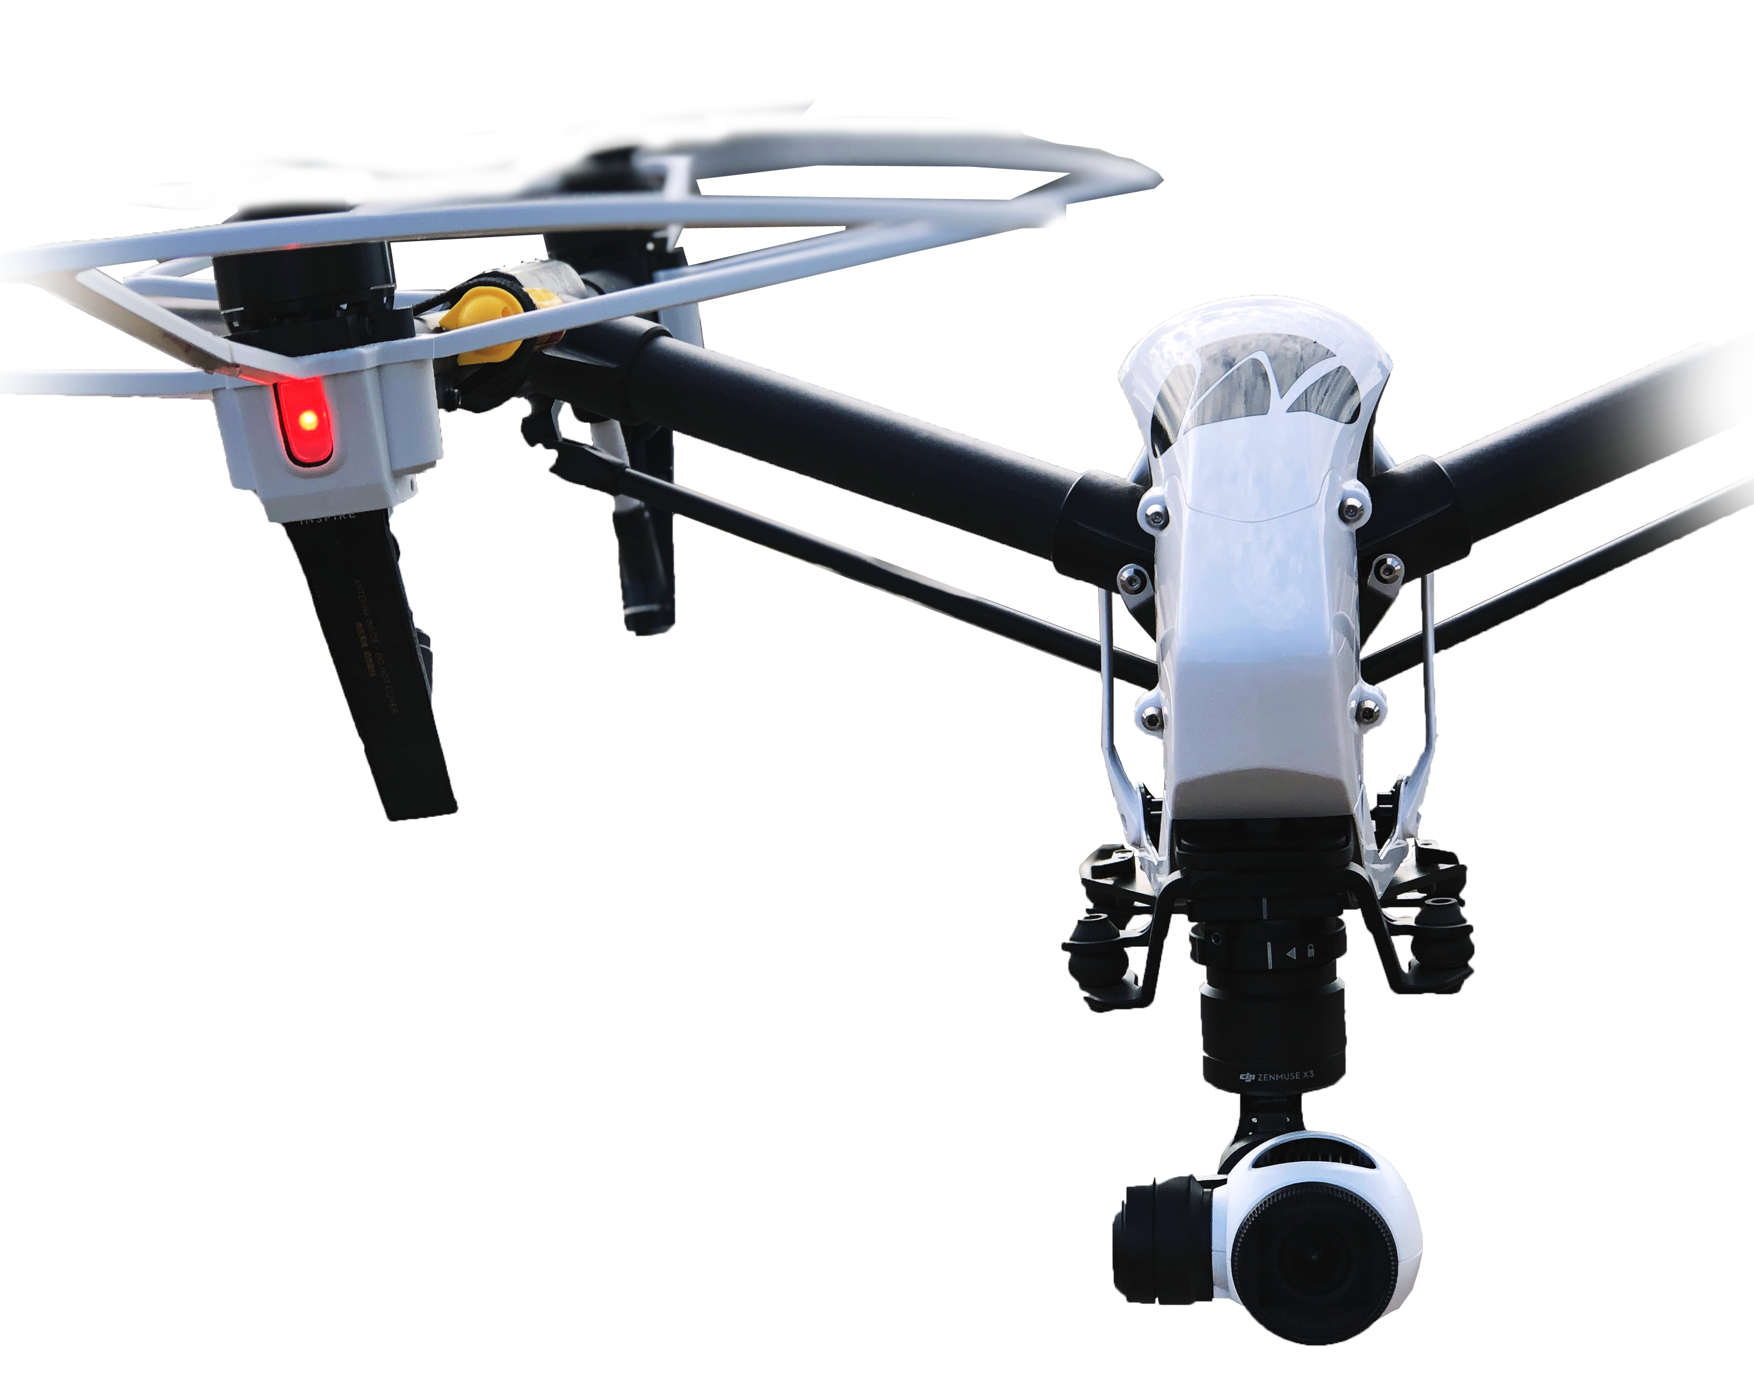
Types of Drones
Types can include helicopter-like structures with a single rotor, fixed wing, and more. Quadcopters are most common due to the stability and ease of operation and are most often used in media production applications.
Types of Control
Drones can be entirely autonomous using sensors like LIDAR, millimeter wave radar, Sonar, GPS, etc.
Drones can be entirely manual, operated by a pilot providing control inputs often through a radio transmitting controller.
Most consumer drones are hybrids; operators provide inputs (e.g. left, right, fwd, back) and the drone interprets these commands into control actions such as changing propeller speed.
Presented by Dan Weecks | www.WeecksProductions.com

Slide 5
Some Popular Uses for Drones
Aerial imaging
Movie Making
Photography
Police/Military tactical situation monitoring
Search and Rescue
Safety inspections of power lines and structures
Topographical or building surveying
Delivery of goods
Search and Rescue applications
Online retail, grocery, etc.
Agriculture
Spraying pesticides
Presented by Dan Weecks | www.WeecksProductions.com

Slide 6
Why Drones instead of regular aircraft?
Pros
Cons
Cost Effective
Budget friendly to purchase
Low operating cost
Versatile Flying Capabilities
Maneuverability
Low altitudes
Increased Safety & Reliability
GPS Satellite connectivity
On-board sensors & auto functions
Shorter Flying Times
10-15 Minutes (usually) per battery
Reduced range
Line of Sight Restrictions
R/C Range
Radio Interference
Altitude Constraints
400’ AGL
OR 400’ above structures
Presented by Dan Weecks | www.WeecksProductions.com

Slide 7
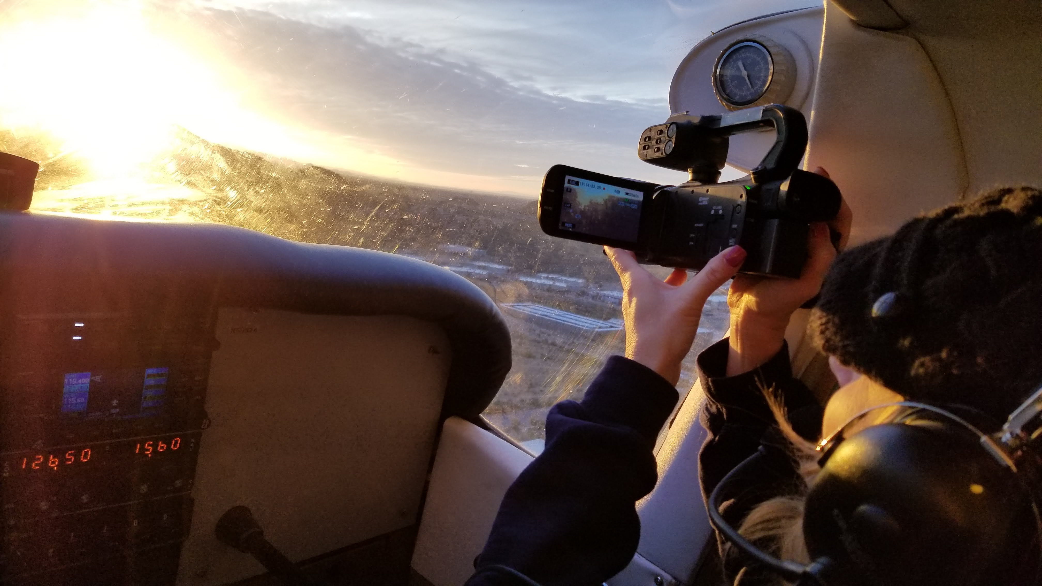
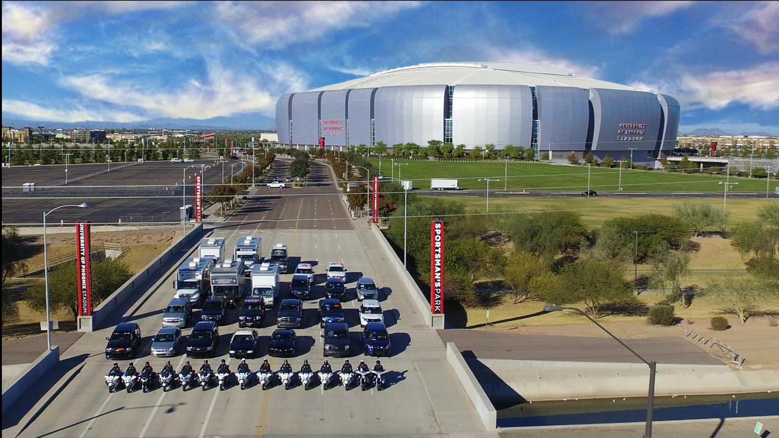
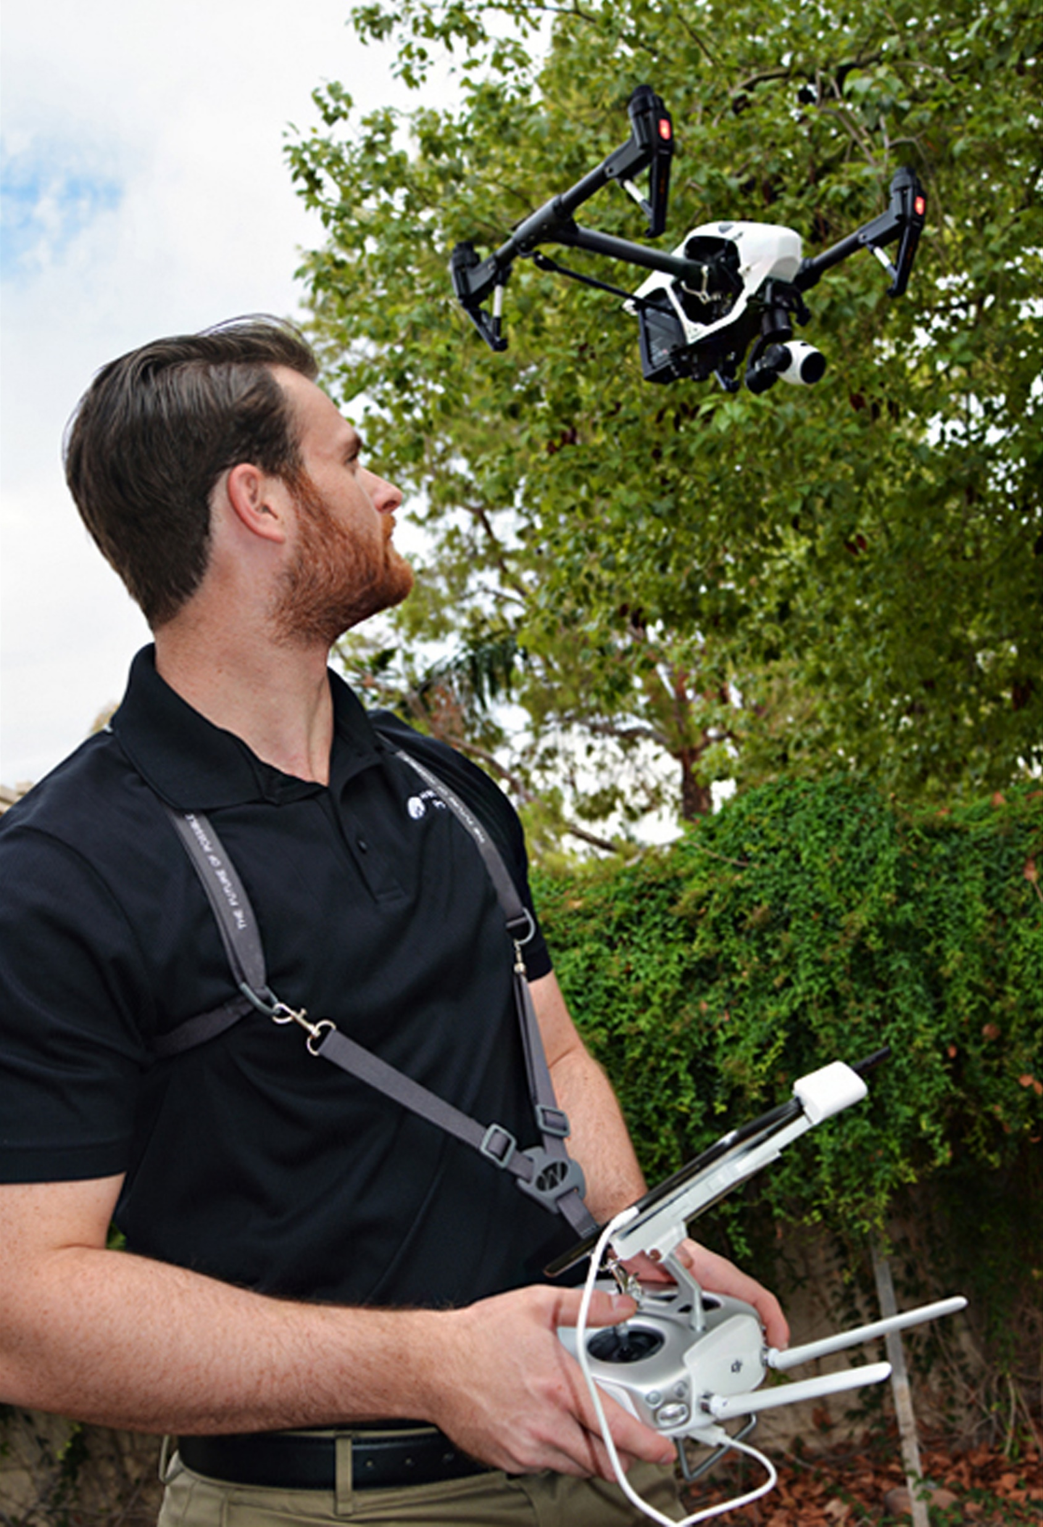
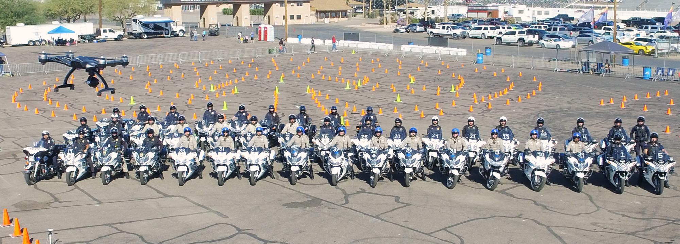
Use cases of Aerial Imaging

Slide 8
What are the rules regulating drones?
www.faa.gov/uas/getting_started/
In the United States, the Federal Aviation Administration (FAA) is an agency of the U.S. Department of Transportation which provides regulation and oversight of civil aviation within the US to ensure safety.
From the FAA’s website:
The FAA rules you need to follow while flying your drone will depend on what your mission is.
Recreational Flyers & Modeler Community-Based Organizations
Certificated Remote Pilots including Commercial Operators
Public Safety and Government
Am I a “commercial operator”?
If you make money in any way from using a drone, YES.
If you do not make money in any way from using a drone, probably no, HOWEVER:
Use the FAA’s identification tool to make sure prior to flying².
Presented by Dan Weecks | www.WeecksProductions.com

Slide 9
14 CFR Part 107
The Code of Federal Regulations Title 14 Part 107 is what governs commercial drone operators³.
Basic Operational Limitations
Any drones over 0.55lbs MUST be registered with the FAA, regardless of use intent ($5, valid for 3 years).
DroneZone.FAA.gov
“Failure to register an unmanned aircraft that is required to be registered may result in regulatory and criminal penalties. The FAA may assess civil penalties up to $27,500. Criminal penalties include fines up to $250,000 and/or imprisonment for up to three years.”
sUAS aircraft must weigh less than 55lbs
sUAS must always remain within a visual line of sight to the operator.
sUAS cannot operate over people who are not directly participating in the operation, not under a covered structure, and not inside a covered stationary vehicle.
Daylight operations only.
Maximum groundspeed of 100 mph (87 kts).
Maximum altitude of 400’ AGL (above ground level), or within 400’ of a structure if higher than 400’ AGL.
No operations from a moving aircraft. No operations from a moving vehicle unless operating over a sparsely populated area.
No careless or reckless operations. No carriage of hazardous materials.
Requires preflight inspection by Remote Pilot in Command.
Etc.
Presented by Dan Weecks | www.WeecksProductions.com

Slide 10
14 CFR Part 107
The Code of Federal Regulations Title 14 Part 107 is what governs commercial drone operators³.
Remote Pilot in Command Certification and Responsibilities
Must hold a remote pilot airman certificate with a small UAS rating, or be under the supervision of someone who holds a remote pilot certification.
To qualify for a remote pilot certification, a person must:
Demonstrate aeronautical knowledge by either:
Passing an initial aeronautical knowledge test at an FAA-approved knowledge testing center; or
Hold a part 61 pilot certificate other than student pilot, complete a flight review within the previous 24 months, and complete a small UAS online training course provided by the FAA.
Be vetted by the Transportation Security Administration.
Be at least 16 years old.
Part 61 pilot certificate holders may obtain a temporary remote pilot certificate immediately upon submission of their application for a permanent certificate. Other applicants will obtain a temporary remote pilot certificate upon successful completion of TSA security vetting. The FAA anticipates that it will be able to issue a temporary remote pilot certificate within 10 business days after receiving a completed remote pilot certificate application
Presented by Dan Weecks | www.WeecksProductions.com

Slide 11
14 CFR Part 107
The Code of Federal Regulations Title 14 Part 107 is what governs commercial drone operators³.
A remote pilot in command must:
Make available to the FAA, upon request, the small UAS for inspection or testing, and any associated documents/records required to be kept under the rule.
Report to the FAA within 10 days of any operation that results in at least serious injury, loss of consciousness, or property damage of at least $500.
Conduct a preflight inspection, to include specific aircraft and control station systems checks, to ensure the small UAS is in a condition for safe operation.
Ensure that the small unmanned aircraft complies with the existing registration requirements specified in § 91.203(a)(2).
A remote pilot in command may deviate from the requirements of this rule in response to an in-flight emergency.
Presented by Dan Weecks | www.WeecksProductions.com

Slide 12
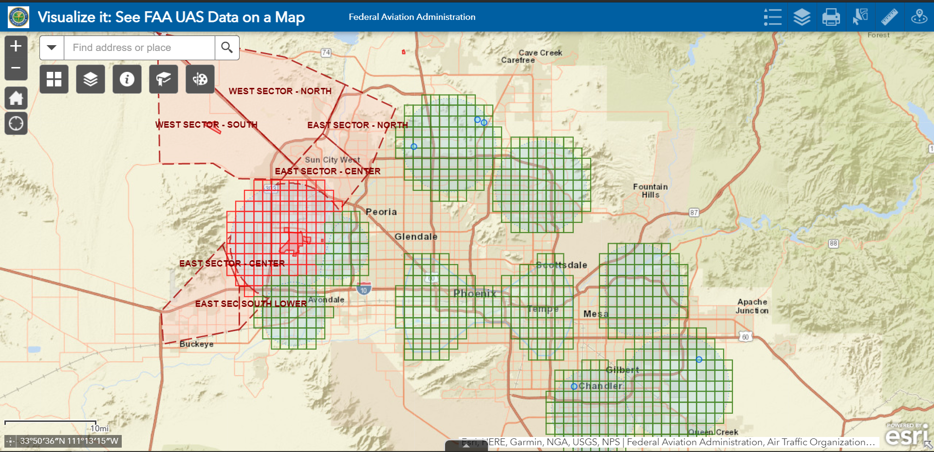
Operating a Drone
Ensure your drone is registered at faadronezone.faa.gov.
Download FAA’s “B4UFLY” Mobile App and check airspace and flight conditions prior to flight.
If on the computer, use the FAA’s “Visualize It” Map to verify clear of airspace at intended location.
If your intended location is in controlled airspace, either use the B4UFLY/Kittyhawk mobile app to request automated LAANC authorization.
If LAANC is not available, you can submit a waiver request for manual authorization at faadronezone.faa.gov.
Check Notices to Airmen (NOTAMs), and Temporary Flight Restrictions (TFRs) on FAA’s Drone Zone, or TFR.FAA.gov/NOTAMs.FAA.gov
Check Weather on KittyHawk app or AviationWeather.gov
Presented by Dan Weecks | www.WeecksProductions.com

Slide 13
Operating a Drone
*Drone must be visibly marked with registration number when operating.
**Preflight inspection must be completed before every flight.
***Checklists are highly recommended, although not required
If embedded video doesn’t work, it can be found at:
https://youtu.be/cWH92umG2L0
Presented by Dan Weecks | www.WeecksProductions.com

Slide 14
Upcoming Changes
On December 31, 2019, the FAA issued a Notice of Proposed Rulemaking on Remote Identification for UAS. This will require most drones operating in US airspace to have “remote ID” capability ⁵.
This integration will likely allow for expanded operations by mitigating risks, since new technological and operational innovation will be occurring to ensure compliance.
Night-time operations may be permissible.
Operations over people and crowds may be permissible.
Presented by Dan Weecks | www.WeecksProductions.com

Slide 15
What new operations do you think may be possible with new drone technologies?
Q&A Session… please ask questions!
Have more questions about drones, or want to learn how to fly drones or airplanes?
Visit DanWeecks.com for more information.

Slide 16
References
¹ ”Small Unmanned Aircraf System (sUAS)_Categorization Framework for Low Altitude Traffic Services - https://utm.arc.nasa.gov/docs/2017-Ren_DASC17.pdf
² https://www.faa.gov/uas/getting_started/user_identification_tool/
³ https://www.faa.gov/uas/commercial_operators/
⁴ Part 107 Summary - https://www.faa.gov/uas/media/Part_107_Summary.pdf
⁵ Drone Remote ID - https://www.faa.gov/uas/getting_started/remote_id/
⁶ “Visualize It” UAS Data on a Map - https://www.arcgis.com/apps/webappviewer/index.html?id=9c2e4406710048e19806ebf 6a06754ad
Presented by Dan Weecks | www.WeecksProductions.com

